Slide 1
Infrastruktura Big Data

Slide 2
Agenda
Data Warehouse
Data Lakehouse

Slide 3
Data Mesh, Data Fabric, Data Lakehouse - SQLBits 2022 - YouTube
https://docs.microsoft.com/en-us/azure/cloud-adoption-framework/scenarios/data-management/architectures/reference-architecture-data-mesh
MS example
https://mrpaulandrew.com/2021/12/15/building-a-data-mesh-architecture-in-azure-part-1/
First part of series, criticism and first try on howto
https://www.jamesserra.com/archive/2021/02/data-mesh/
Also lot of criticism, more theory and assumptions
https://lingarogroup.com/blog/comparing-data-mesh-with-traditional-data-platform-architectures/
Mainly theory

Slide 4

Data Warehouse

Slide 5
Historia
Dane były w systemach
Padły pytania od biznesu .. co się dzieje
Pobierz dane z systemu transakcyjnego trudne
Zbieramy dane pakujemy w jedno scentralizowane miejsce i gotowe
Zaczęły się problemy jak przybyło danych (text, IoT, images, audio, videos, drones, etc. )

Slide 6
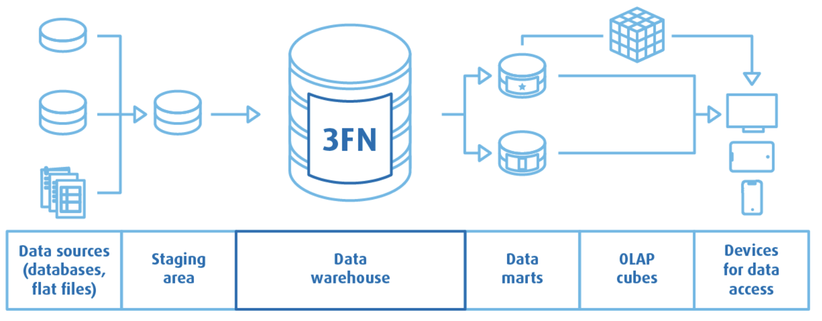
Architektura Data Warehouse
Bill Inmon - data is stored in the normalized form E-R model/normalized model.

Slide 7
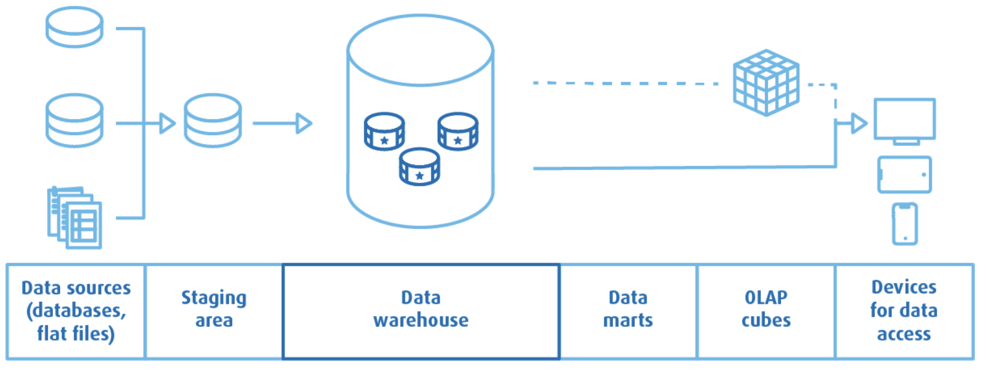
Architektura Data Warehouse
Ralph Kimball - Dimensional Model (star schema / snowflake )

Slide 8
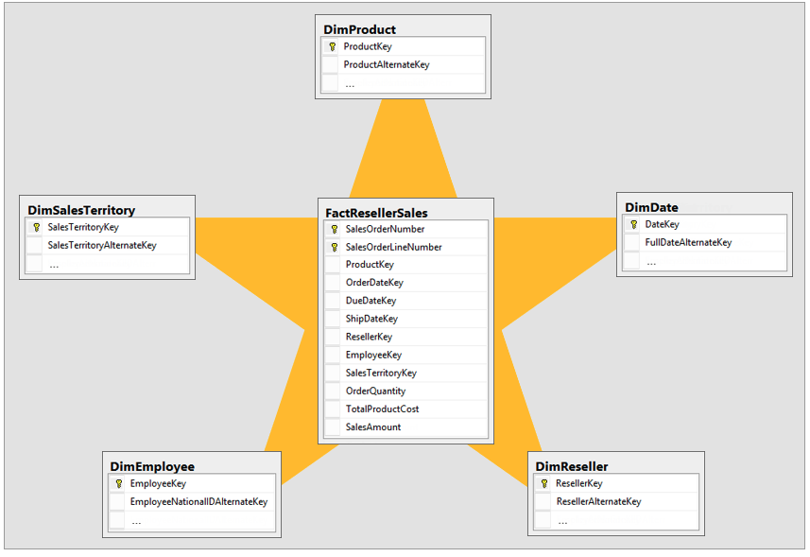
Star Schema (table faktów i wymiarów)

Slide 9
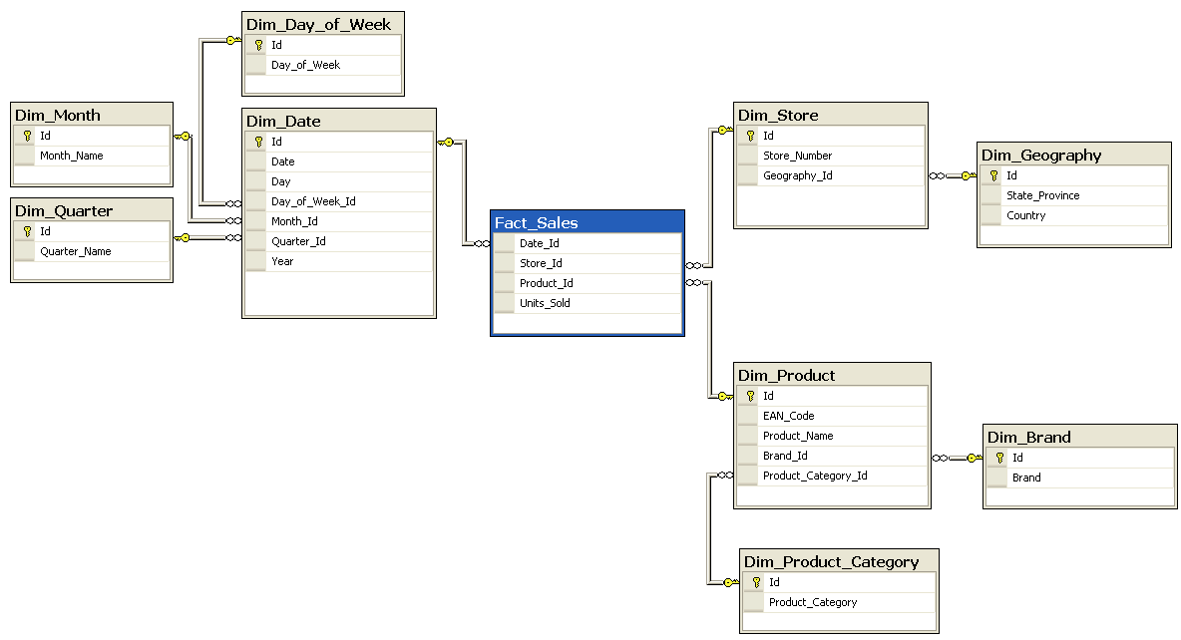
Snowflake Schema

Slide 10
Normalization
First Normal Form (1NF)
Eliminate duplicative columns from the same table
Create separate tables for each set of related data
Identify each row with a unique column (the primary key)
Second Normal Form (2NF)
Meet all the requirements of the first normal form
Remove subsets of data that apply to multiple rows of a table and place them in separate tables
Create relationships between these new tables and their predecessors through the use of foreign keys
Third Normal Form (3NF)
Meet all the requirements of the second normal form
Remove columns that are not dependent upon the primary key

Slide 11
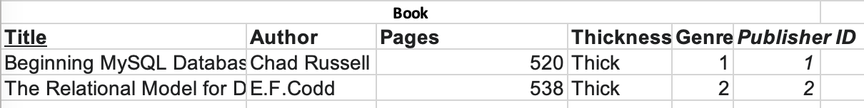
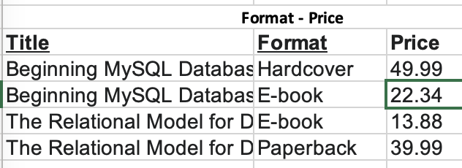
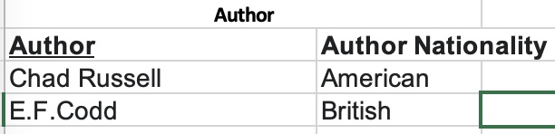
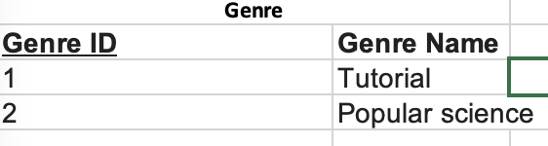
Normalizacja danych
Normalization - no duplicates, reduces repetitive data, OLTP database.
Denormalized - containing duplicate data.

Slide 12
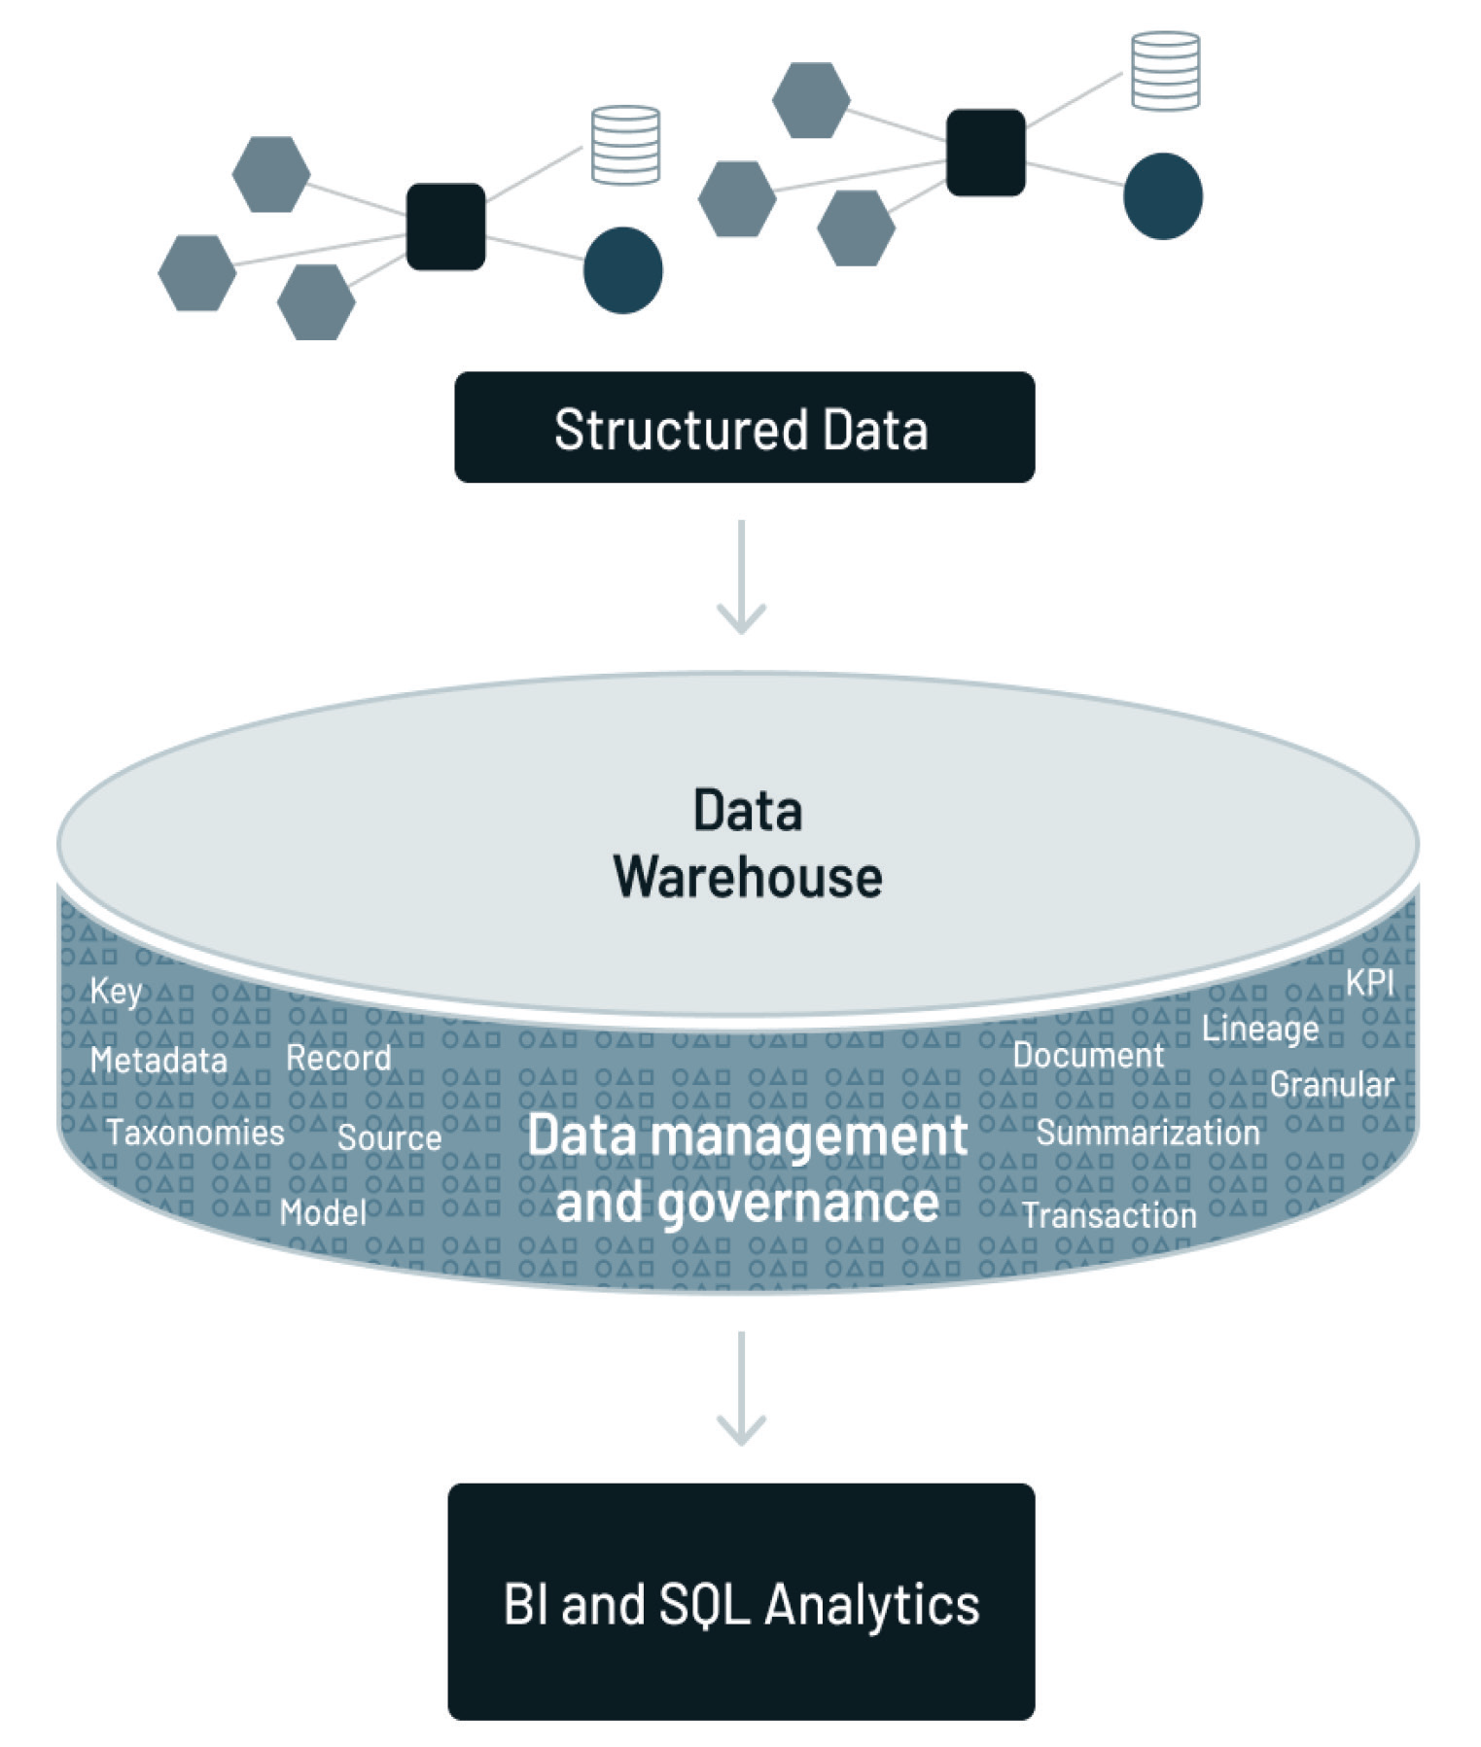
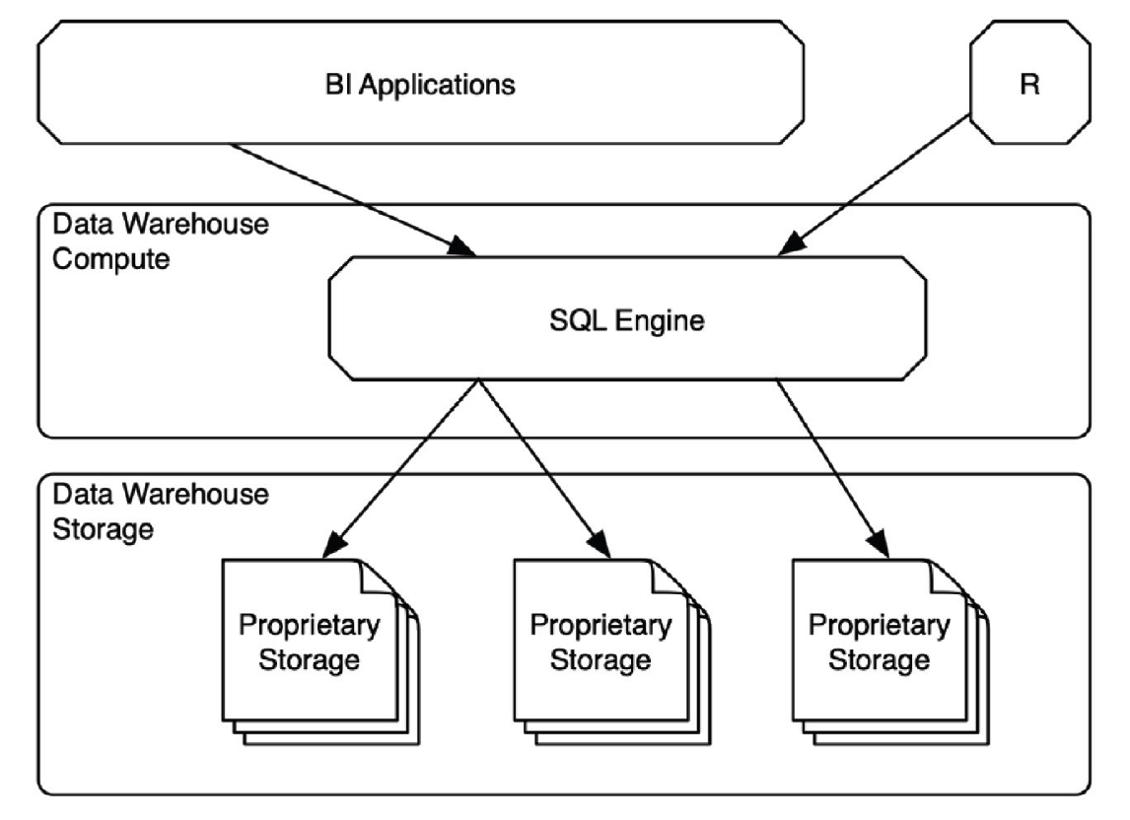
Integracja danych

Slide 13
Data Lakehouse

Slide 14
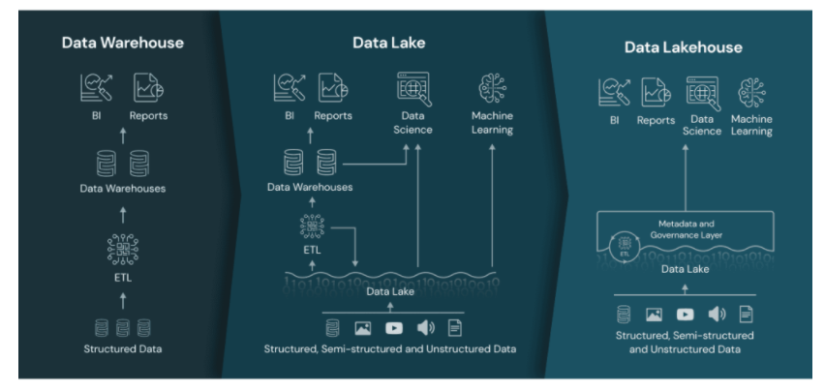
What Is a Lakehouse?
https://databricks.com/blog/2020/01/30/what-is-a-data-lakehouse.html?utm_source=newsletter&utm_medium=email&utm_campaign=co_przyniesie_rok_2022&utm_term=2022-03-07

Slide 15
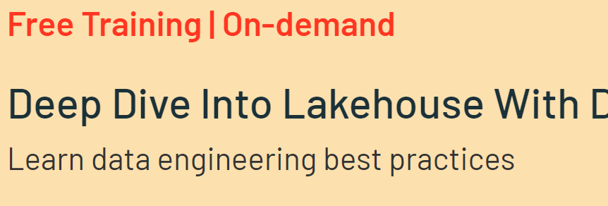
Deep Dive Into Lakehouse With Delta Lake
https://databricks.com/p/webinar/deep-dive-into-lakehouse-with-delta-lake-complimentary-training?utm_source=databricks&utm_medium=email&utm_campaign=7013f000000Ljo2AAC&utm_content=v1p

Slide 16
Komponenty infrastruktury analitycznej
Metadata—a guide to what data was located where
Data model—an abstraction of the data found in the data warehouse
Data lineage—the tale of the origins and transformations of data found in the data warehouse
Summarization—a description of the algorithmic work to create the data in the data warehouse
KPIs—where are key performance indicators found
ETL—technology that allowed applications data to be transformed automatically into corporate data

Slide 17
Data Lake
The data lake is an amalgamation of all of the different kinds of data found in the organization.
Different data types with different characteristics, volumes, complexity
Low storage costs
Metadata
Lineage of the data
Volumetric measurements
Historical records of creation
Transformation descriptions
The universal common connector allows data of all varieties to be combined and compared using traditional techniques and ML.
Data Lake > Data Lakehouse

Slide 18
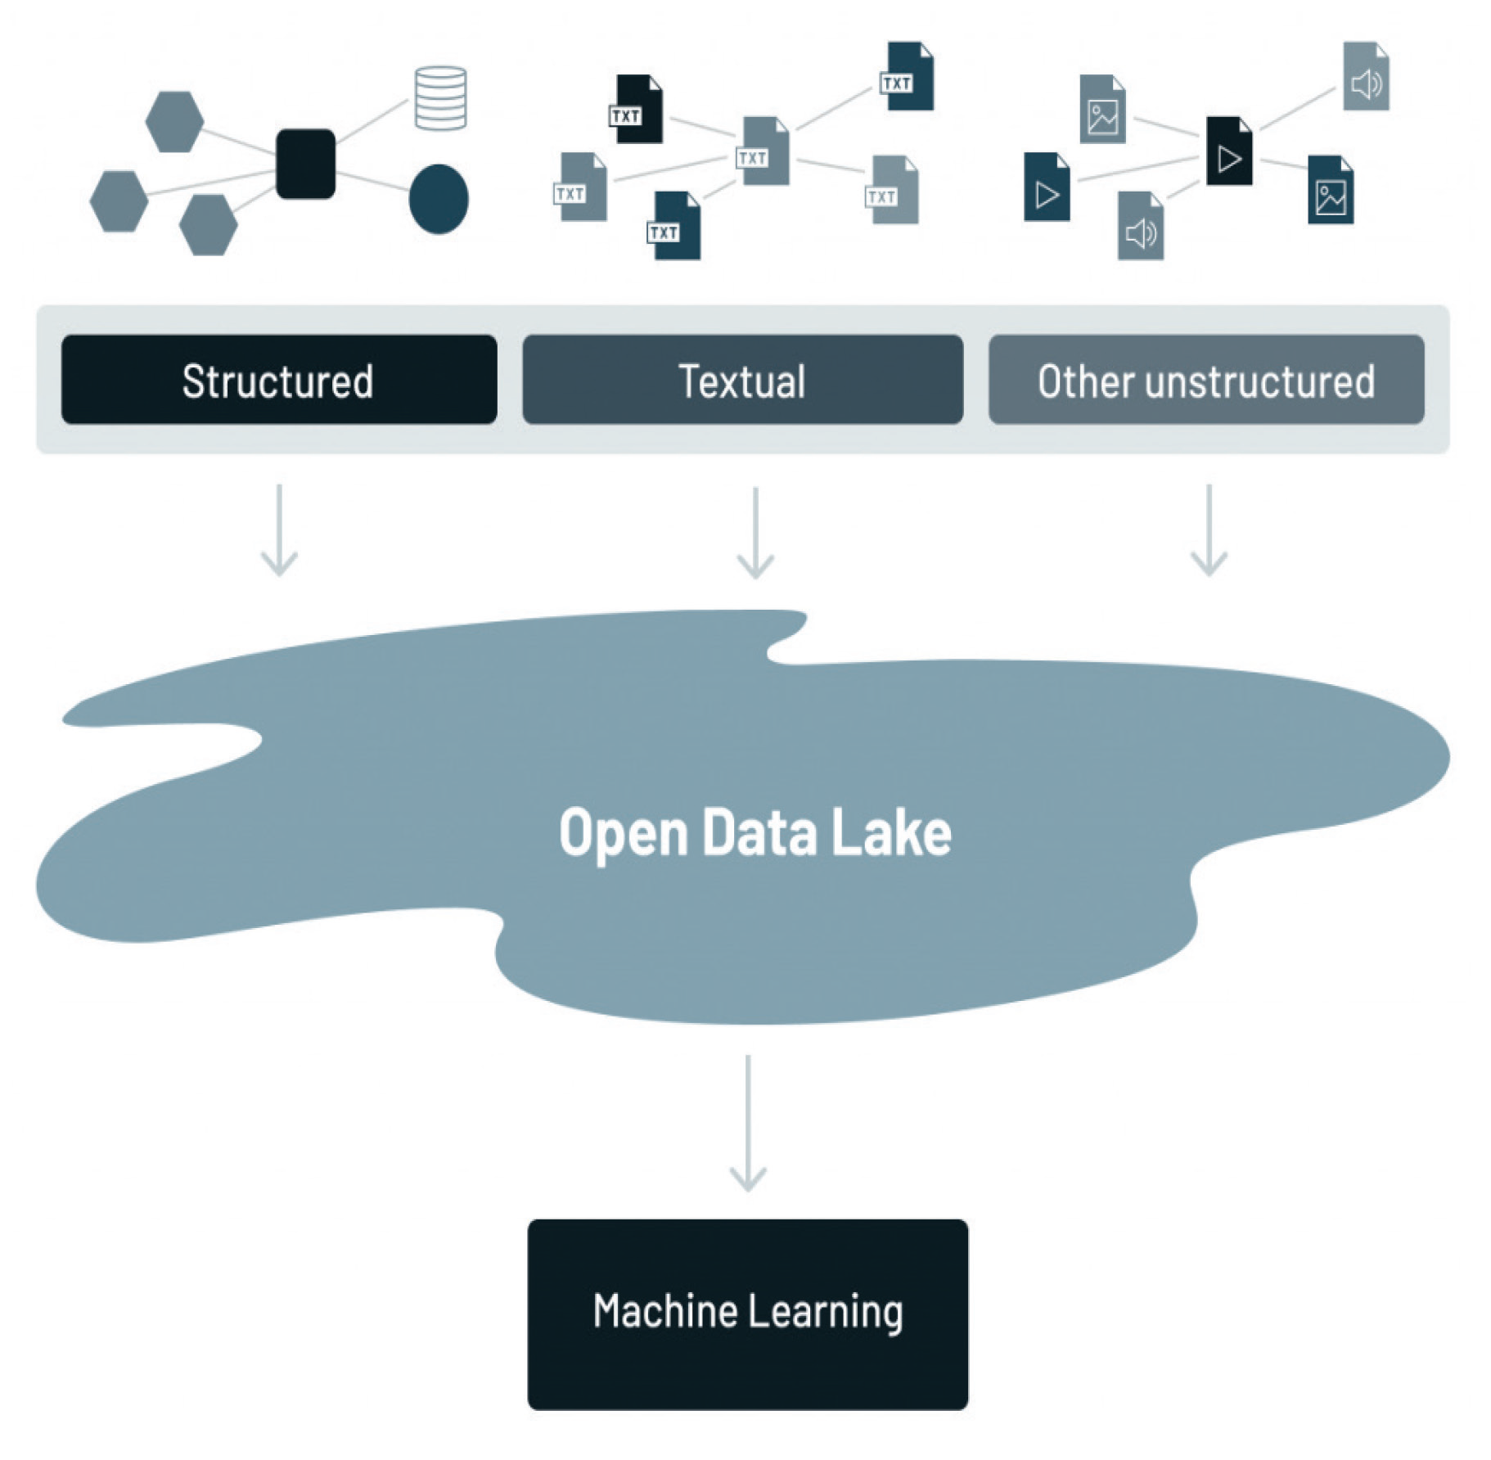

Slide 19
Problemy
Where was the data that was needed?
How did one unit of data relate to another unit of data?
Was the data up to date?
How accurate was the data?
No support for transactions,
No enforcement of data quality or governance
Poor performance optimizations.
Limited support for ML

Slide 20
Architektoniczne wyzwania
Expensive data movement with dual architecture
Majority of data is in data lake.
(Extract/Transform/Load) to copy a small subset of data in the data lake to a downstream data warehouse for the most important decision support and BI applications.
Costly to maintain dual processing
Limited support for machine learning (TensorFlow, PyTorch, XGBoost).
Lack of openness (SQL Only).

Slide 21
Data Lakehouse komponenty
Data from the structured environment
Data from the textual environment
Data from the analog/IoT environment
An analytical infrastructure allowing data in the lakehouse to be read and understood
Data structures and data management features from a data warehouse but operating directly on the kind of low-cost storage used for data lakes.

Slide 22
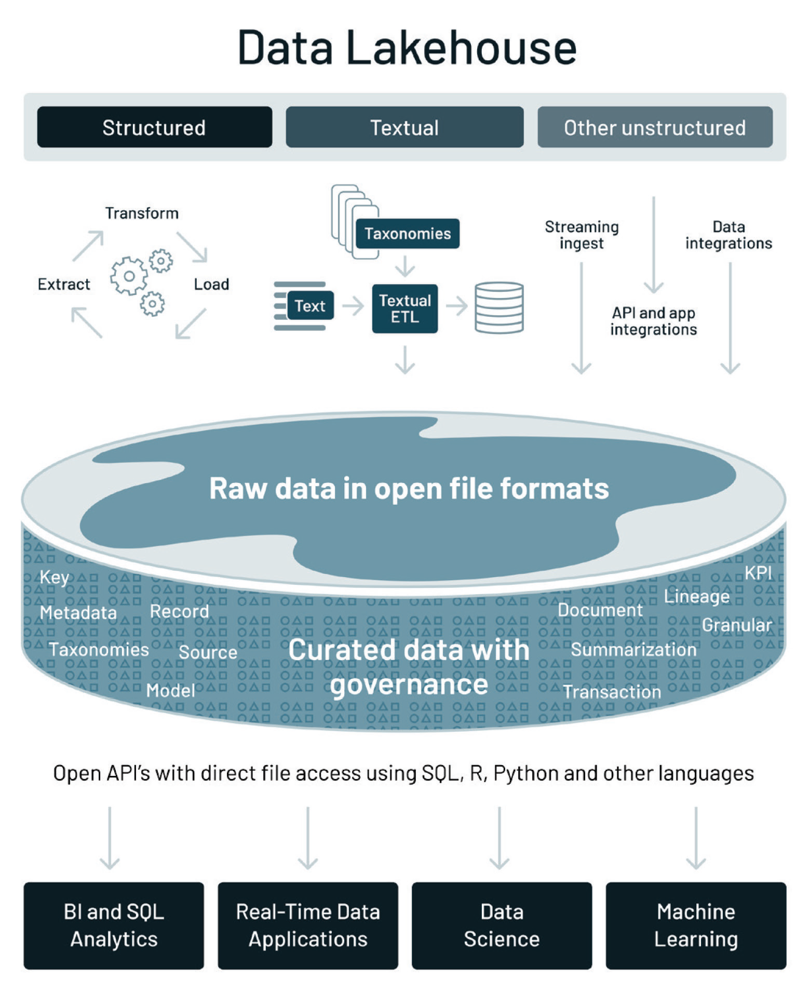

Slide 23
Proces budowania Lakehouse
Taking a lake-first approach
Bringing reliability and quality to the data lake
ACID
Support for DW schema architectures like star/snowflake-schemas
Schema evolution
Adding governance and security controls
DML support
Full audit trail for historical changes
Data snapshot
Role based access control
Optimizing performance
Caching, multi-dimensional clustering, z-ordering, and data skipping
Support for ML
Reads for large volumes of data
Data versioning for ML experiments
Dataframe API
Openness
Parquet, ORC, Avro
Open API, no need for propriety engines

Slide 24
Porównanie
 | Data Warehouse | Data Lake | Data Lakehouse
Format | Closed, proprietary | Open | Open
Typy danych | Ustrukturyzowane czasami wsparcie dla semi | Wszystkie typy | Wszystkie typy
Dostęp | Tylko SQL | Owarty API | Otwarty API
Niezawodność | ACID, wysoka | Niska | ACID, wysoka
Osiągi | Szybko | Wolno | Szybko
Magazyn danych | Drogi w skalowaniu | Tani | Tani
Narzędzia | SQL, BI | Limit na ML | BI, SQL, ML, Języki..

Slide 25
Consumers
Data Lake
Raw data from multiple sources
The analytical infrastructure
Identify how data related to each other
Identify the timeliness of data
Examine the quality of the data
Identify the lineage of data
Different audience for each type using different tools

Slide 26
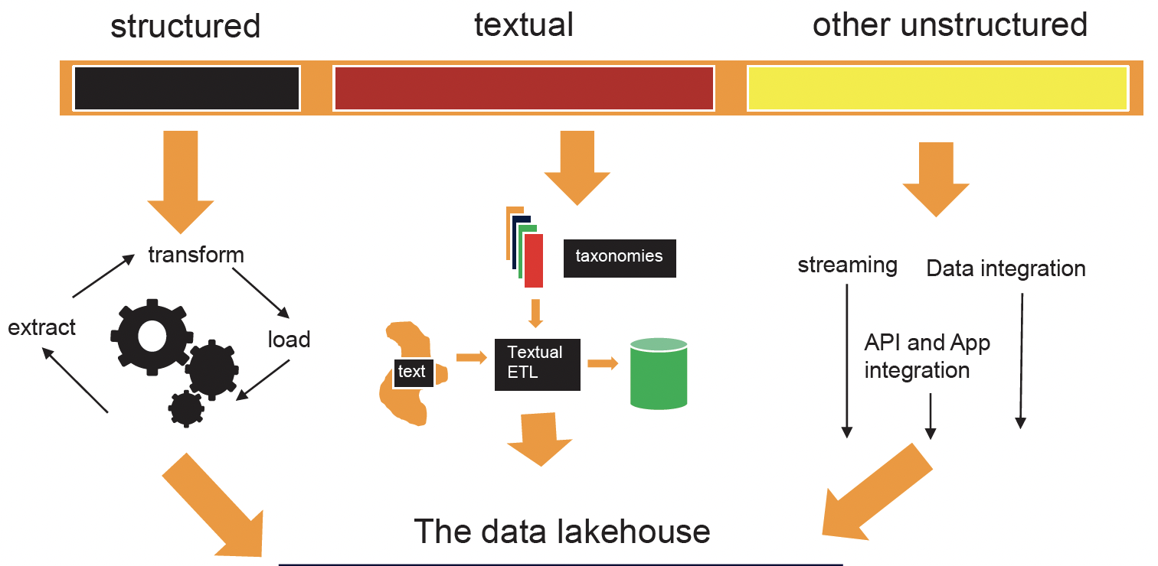
The Lakehouse
Amalgamation of different types of data with their own characteristics
< - Volume

Slide 27
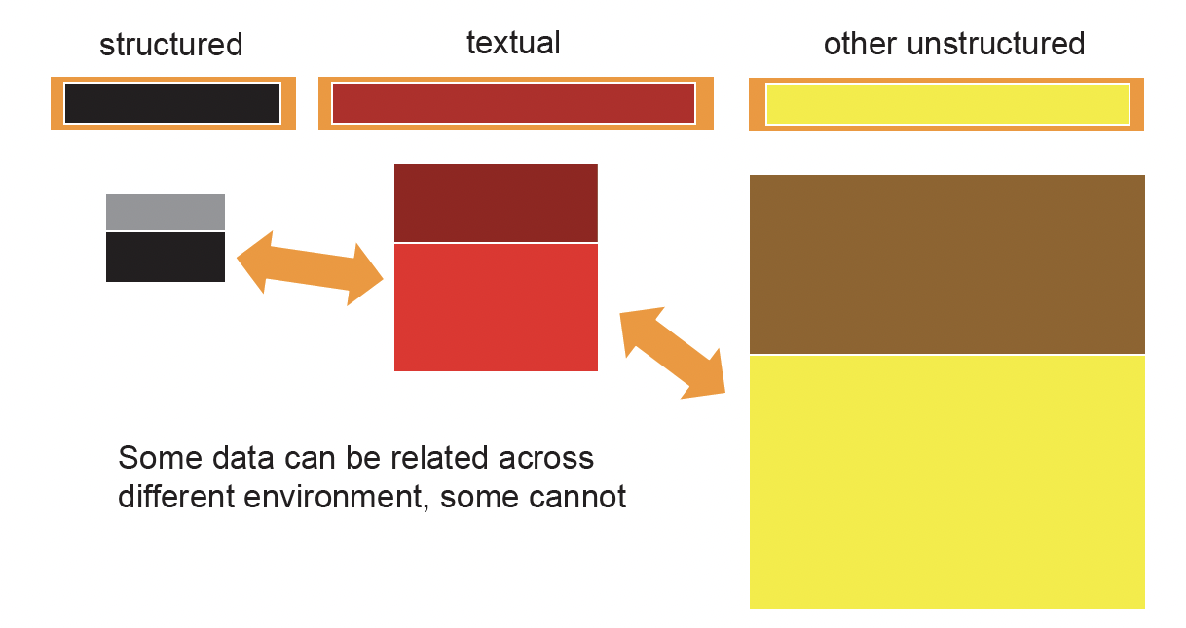
Pros of Lakehouse
Relating data across diverse types of data and environments, requiring common key

Slide 28
Connectors
When there is no common key across the different types of data, it is possible to use a universal connector (a way of connect when there is no formal method).
Common connectors:
Geography/location
Time
Dollar amounts
Name
Gender
Age
Race
Weight

Slide 29
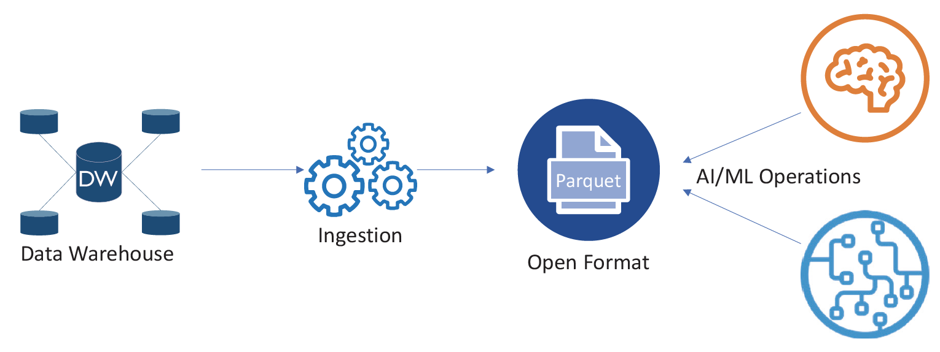
Open format

Slide 30
Avoid data swamp
open metadata logical layers to enable data management Delta Lake (Databricks), Hudi (Uber), Iceberg (Netflix)
Features:
ACID: Atomic, Isolated, Consistent, and Durable (inserted, updated, merged)
Zero-copy: cloning without duplicating the data
Time travel: Keeps history of changes run against tables at a specific point in time.
multiple engines can be connected to the lakehouse to perform their processing.

Slide 31
Open format
Data warehouse only sql
Difficult to migrate stored procedures from Oracle to SQL Server or Teradata.
Enabling a fast-growing ecosystem of tools for ETL, ML, and visualization.
Enables data sharing, written once by the provider and shared many times.
Open to visualisation tools
Working with notebook like Jupyter
Data catalog (data about data allows users to search for metrics)

Slide 32
ML Characteristics
Operating on unstructured data like text and images
Requiring learning from massive data sets, not just a sample
Open source tooling to manipulate data as “DataFrames” (programming-language)
Representations of tabular data, rather than with SQL commands
Outputs are models rather than data or reports
Allows to extract value from data

Slide 33
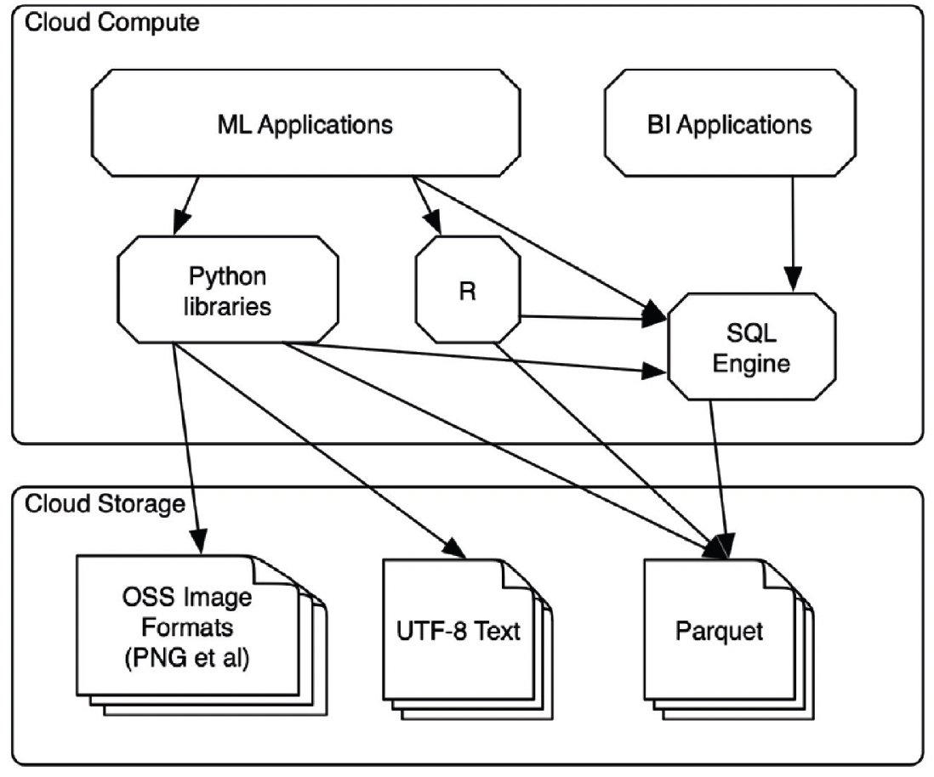
Compare

Slide 34
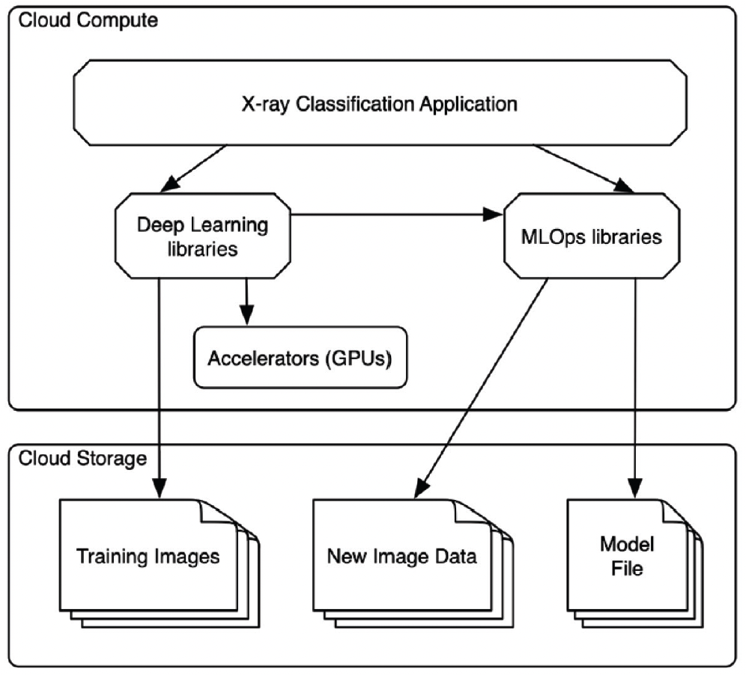
MLOps for data platform
Data versioning, lineage, and model management.
Track how model was created and what exact data
Models are closely related to the data they train on
There are multiple models with versioning of every model
Ability to train model in the same place as data

Slide 35
Analytics infrastructure
Once you combine the data lake along with analytical infrastructure, the entire infrastructure can be called a data lakehouse.
Metadata - what data is in the data lake and how that data is structured
Data model - describes the shape of the data, cardinality of data, referential integrity, indexes, attributes, foreign keys, hierarchical relationships
Lineage of data: see the origins of data and what transformations has been made
Scheduling of processing

Slide 36
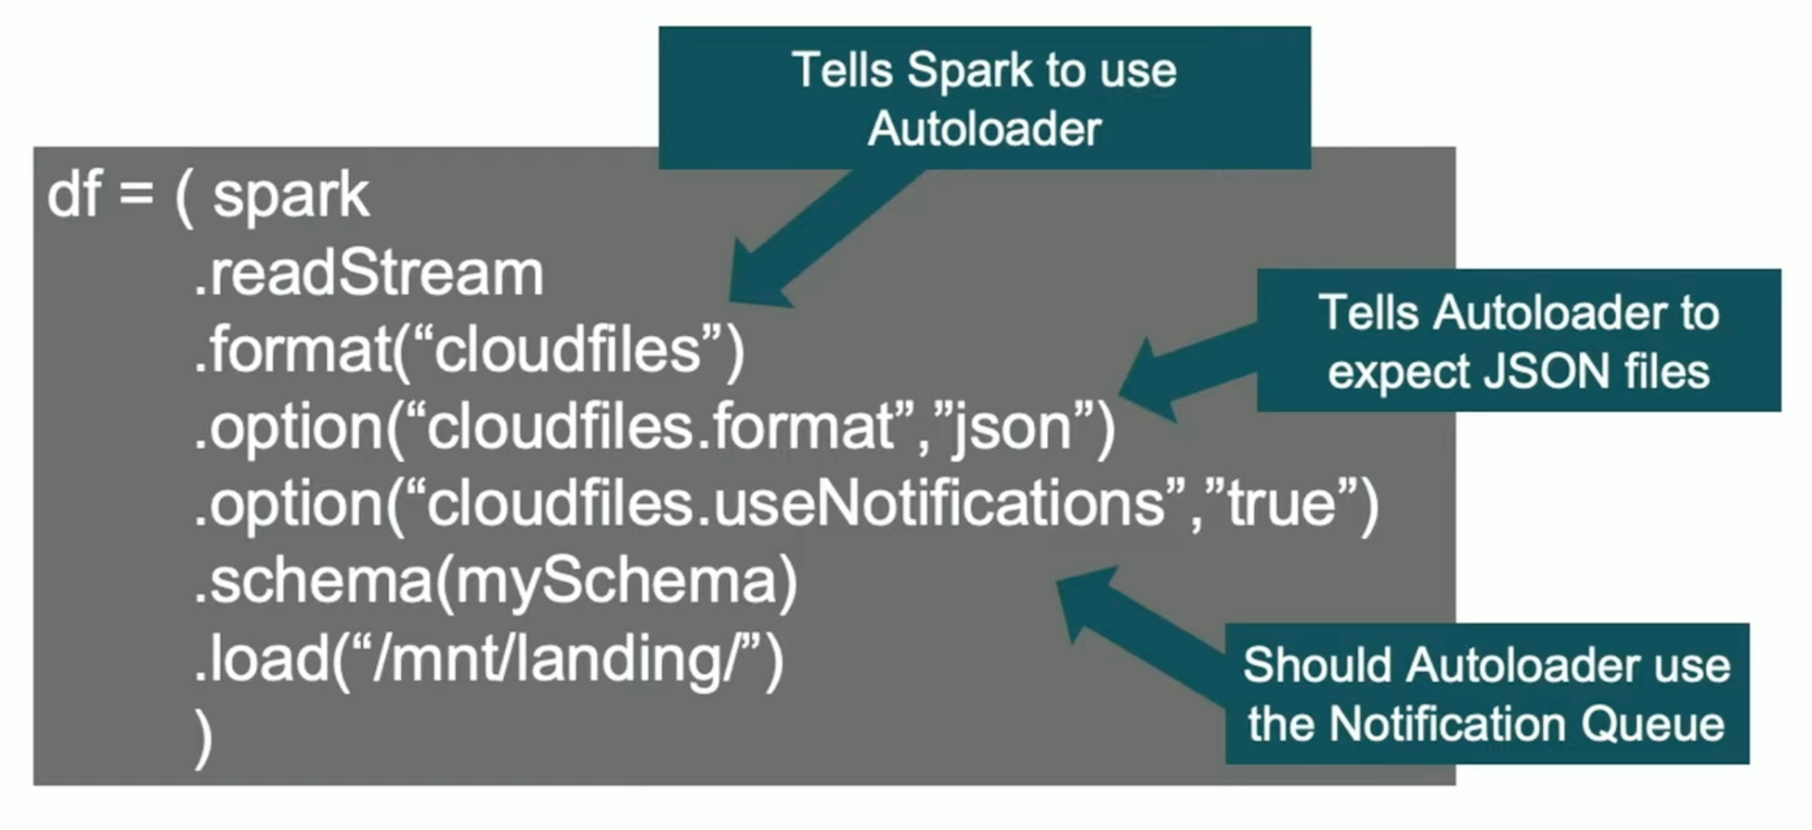
Autoloader
Incremental ingestion:
Process new files automatically, no need to manage state information
Trigger immediately
Stores metadata about what has been read
Using structure streaming
Scalable tracks new files arriving, leverage cloud notification and queue service, millions of files in a directory
Supports batch and streaming, on each batch will scan dir and compare

Slide 37
Housekeeping
How will the data be integrated within the data lakehouse?
How can we manage the master reference within the data lakehouse?
How can we manage the single version of the truth?
What privacy and confidentiality measures need to be considered and applied within the data lakehouse?
How can we make sure that the data is relevant and usable, even decades in the future?
How do we do data lakehouse routine maintenance?

Slide 38
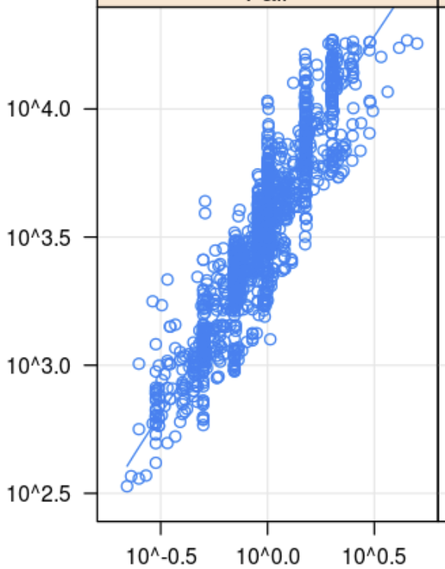
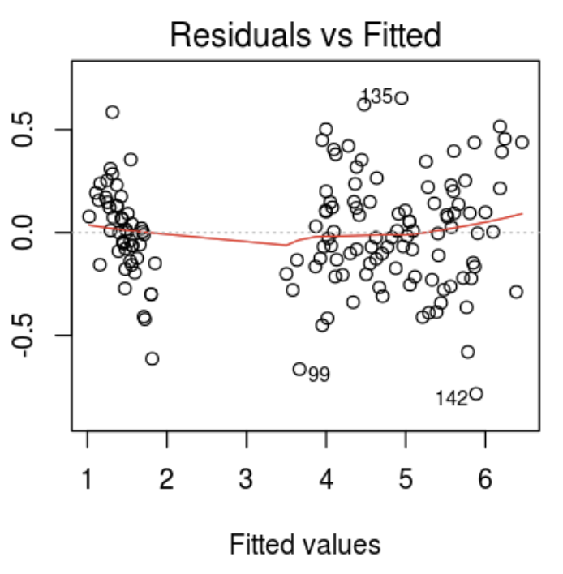
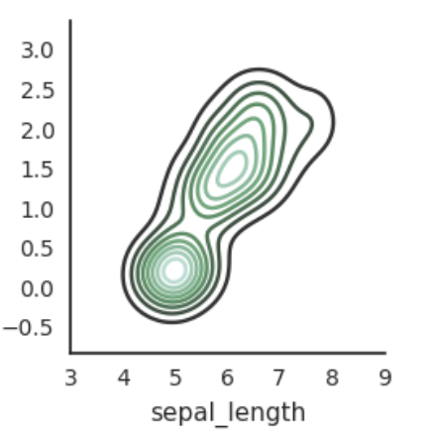
Visualization
Visualizations in Python - Visualizations in R - Visualizations in Scala - Visualizations in SQL
Seaborn / Bokeh / Matplotlib / Plotly
Lattice / DandEFA / Plotly / ggplot2 / htmlwidgets
Information is Beautiful

Slide 39
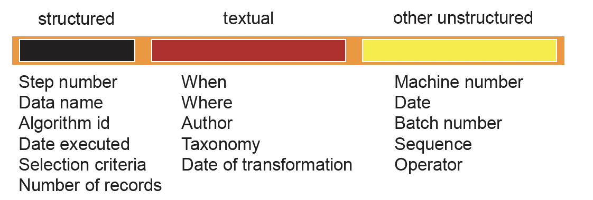
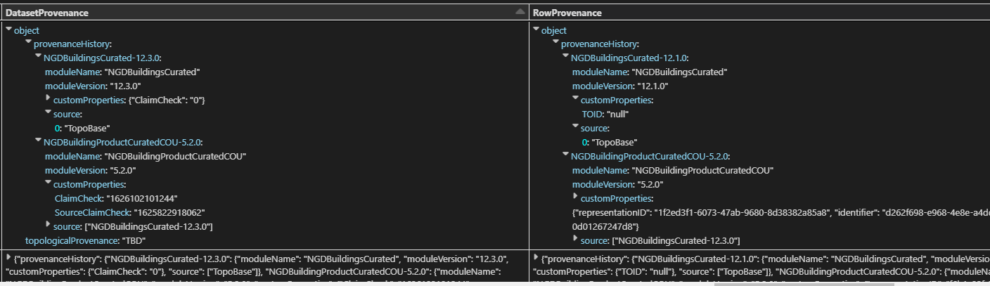
Lineage and Provenance
Lineage -> journey of data from its originating sources to its ultimate destination.
Provenance -> specifically focuses on data sources and their stages

Slide 40
Data arrangements
Physically arrange in accordance with its probability of access.
Segmentation - simpler to process, saving costs (bulk storage, ssd storage)
Data collection over time
Data needs to be collected at a low level of granularity
Aggregate data to minimize searching
Filtering on selected criteria
Data lifecycle

